Slide 1
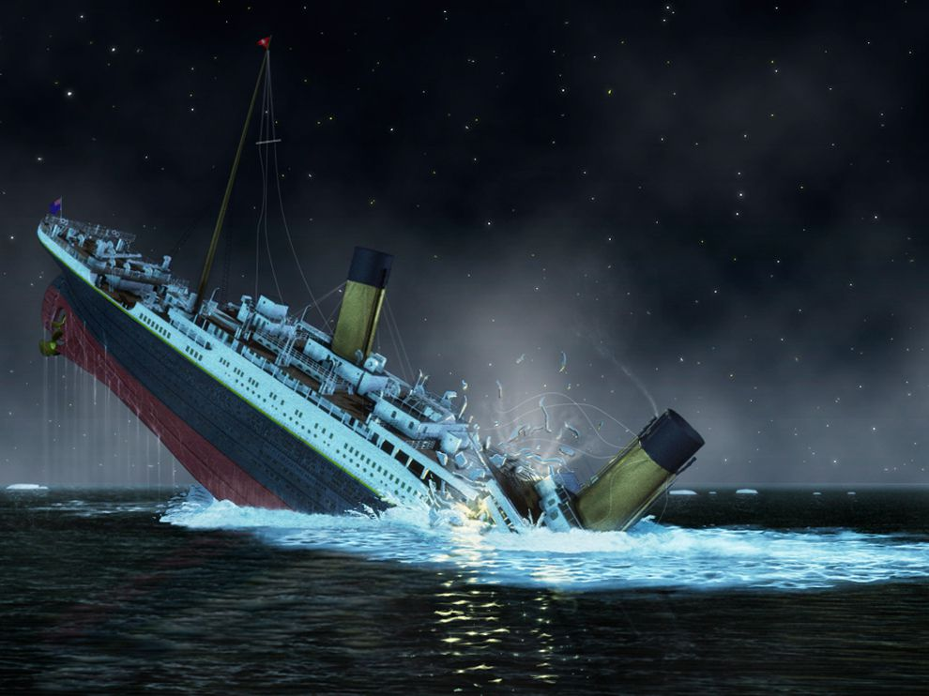
Titanic
Machine Learning from Disaster

Slide 3

Dressing up the data

Slide 4
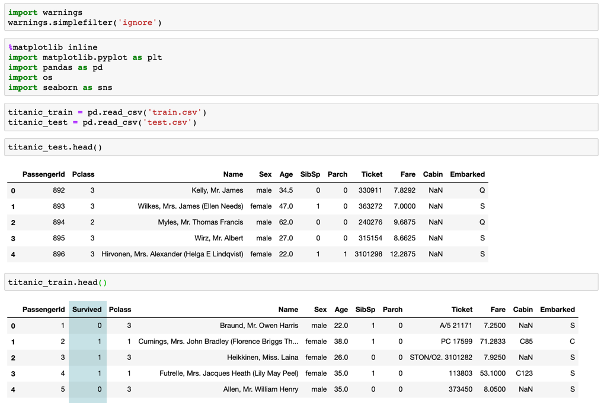
Kaggle.com Datasets
Data was already separated into Test and Train datasets. We chose to focus on the Train data set and further split the data as it had the survived column included and the Test data did not.
Notes:
The reason the Test data was pulled out is to be able to show accuracy in the competition.
We used the Train data.

Slide 5
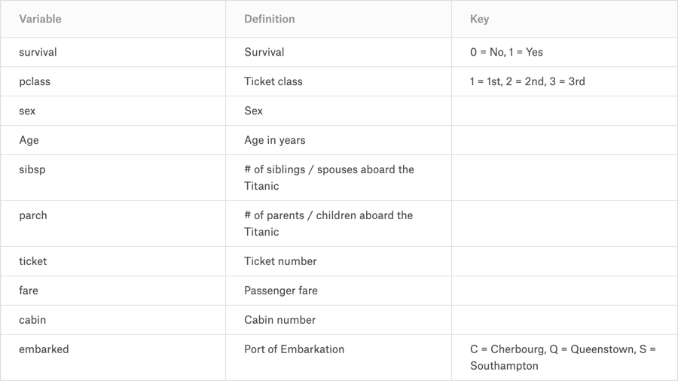
Kaggle.com Data Dictionary

Slide 6
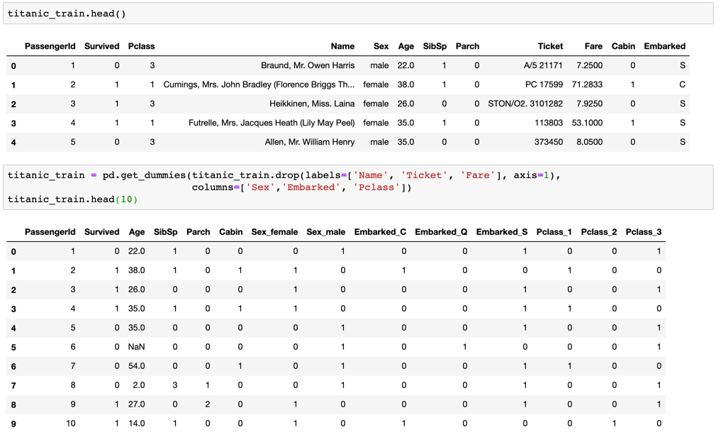
Get Dummies
Even though “Pclass” had multiple values that were numeric (Class 1, 2, and 3) we did not use the get_dummies function since the numeric values did not impact one another.

Slide 7
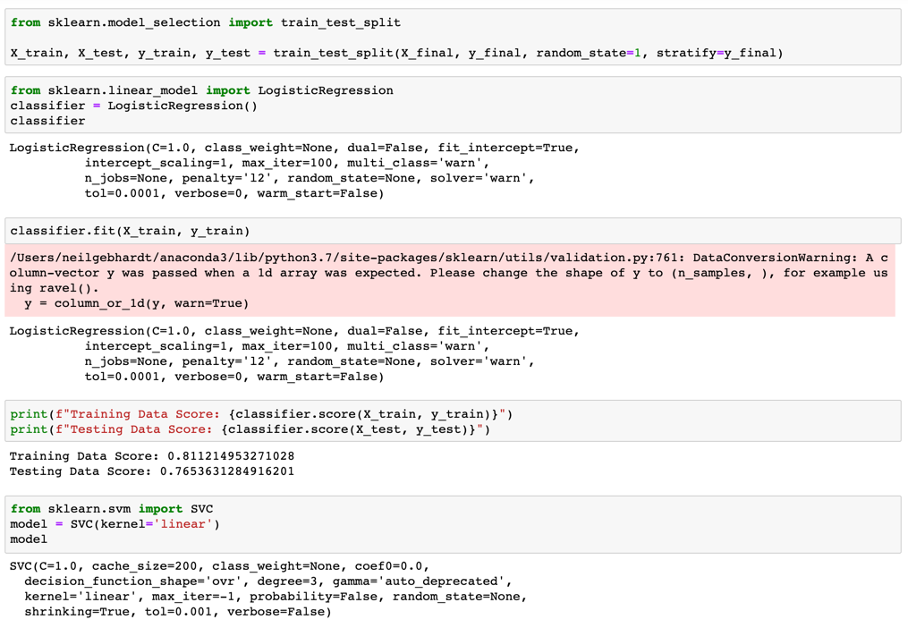
Test, Train and Split!

Slide 8
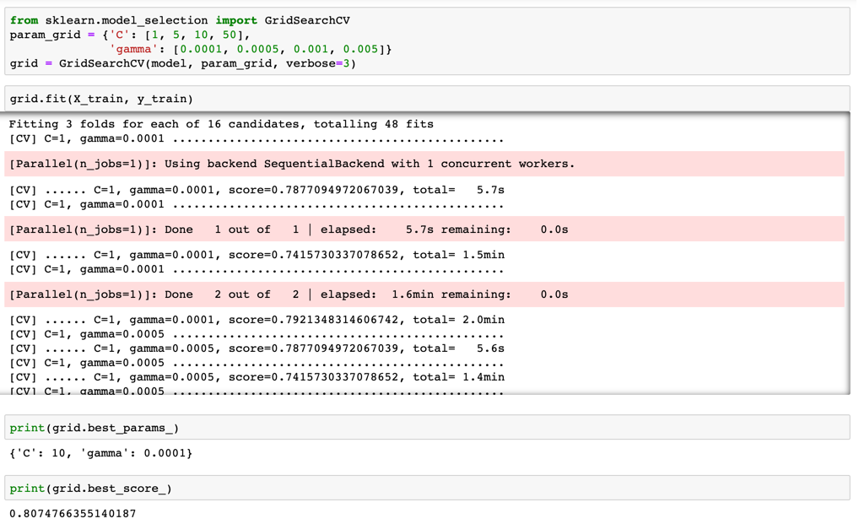
GridSearchCV

Slide 9
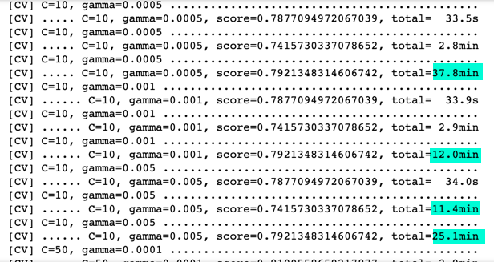
GridSearchCV

Slide 10
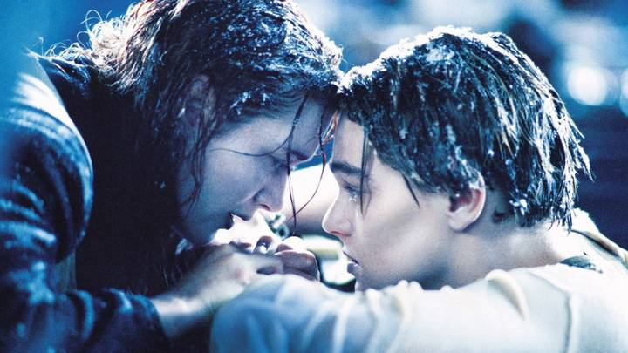
Saving the Model

Slide 11
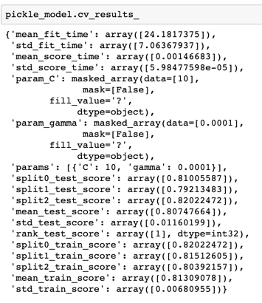
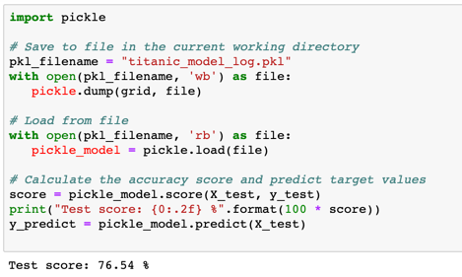
Pickling – Saving our model.

Slide 12

Analyze me
like one of your datasets…

Slide 13
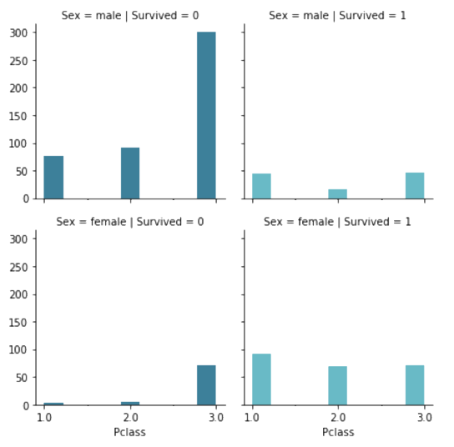
Sex and Class
 | Avg. Fare | Fare Today
1st Class | $ 84.15 | $ 2,182.45
2nd Class | $ 20.66 | $ 535.82
3rd Class | $ 13.68 | $ 354.79
Number of Passengers
1st Class | 216
female | 94
male | 122
2nd Class | 184
female | 76
male | 108
3rd Class | 491
female | 144
male | 347

Slide 14
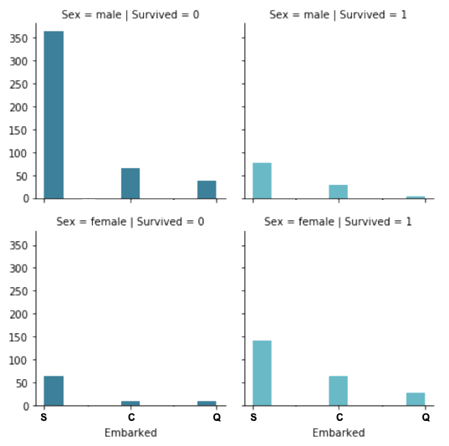
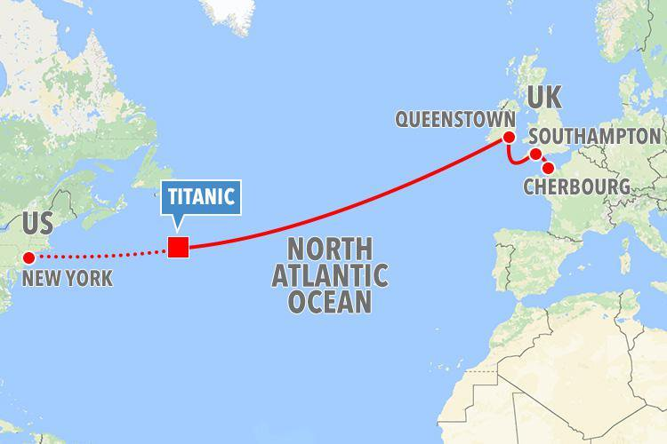
Sex and Embarkation Location
Location | Passengers
Cherbourg | 168
Queenstown | 77
Southampton | 644

Slide 15
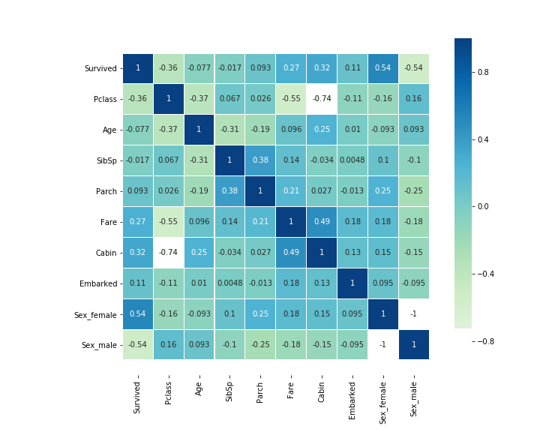
Pearson Correlation
-1 = NEGATIVE linear relationship
You cannot be Male and Female, so you will have a -1 score since the features are not relational.
0 = NO linear relationship
Age and place of embarkation had minimal linear relationship.
1 = POSITIVE linear relationship
Sex_Female and Survived have the greatest linear relationship of two different variables.

Slide 16
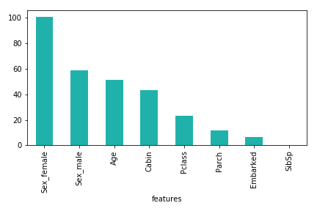
Which feature had the biggest impact on survival?
Using the chi2 function, we were able to discern that being female was the biggest indicator of survival on the titanic.
Females had the highest chance for survival.
Sex | Passengers | Survived | % Survived
Female | 314 | 233 | 74%
Male | 577 | 109 | 19%

Slide 17


Questions?
Notes:
https://www.youtube.com/watch?v=G44xTr8D_bw

Slide 18
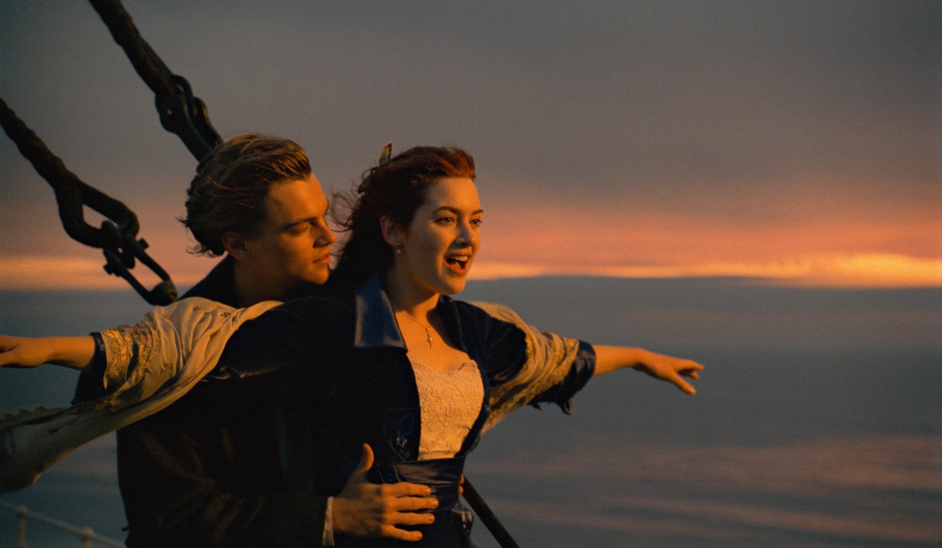
Thank You!

